Slide 1
Activity 1: Kahoot
Notes:
How do we address these problems?
A protective measure or control removes or reduces vulnerabilities. E.g., device, procedure, or technic.

Slide 2
Activity 2: Mentimeter
What makes threats to mobile devices more challenging to manage?
  Mobility of the device, Diverse types of connectivity, Both, None of the two
Which of the following is easier to control?
  Threat, Vulnerability, Both, No idea
Which of the following types of application-level threats do you think is more dangerous in mobile devices?
  Malicious applications, Vulnerable applications

Slide 3
Activity 3: Quiz
1. ____________ gets propagated through networks and technologies like SMS, Bluetooth, wireless medium, USBs and infrared to affect mobile phones.
a) Worms b) Antivirus c) Malware d) Multimedia files
2. ___________ is the protection of smart-phones, phablets, tablets, and other portable tech-devices, & the networks to which they connect to, from threats & bugs.
a) OS Security b) Database security c) Cloud security d) Mobile security
3. Mobile security is also known as ____________
a) OS Security b) Wireless security c) Cloud security d) Database security
4. DDoS in mobile systems wait for the owner of the _____________ to trigger the attack.
a) worms b) virus c) botnets d) programs
5. Hackers cannot do which of the following after compromising your phone?
a) Steal your information b) Rob your e-money c) Shoulder surfing d) Spying

Slide 4
Activity 3: Quiz …
6. Which of the following is not an appropriate way of targeting a mobile phone for hacking?
a) Target mobile hardware vulnerabilities b) Target apps’ vulnerabilities c) Setup Keyloggers and spyware in smart-phones d) Snatch the phone
7. Mobile Phone OS contains open APIs that may be _____________ attack.
a) useful for b) vulnerable to c) easy to d) meant for
8. Hackers cannot do which of the following after compromising your phone?
a) Shoulder surfing b) Accessing your voice mail c) Steal your information d) Use your app credentials
9. App permissions can cause trouble as some apps may secretly access your memory card or contact data.
a) True b) False
10. Activate _____________ when you’re required it to use, otherwise turn it off for security purpose.
a) Flash Light b) App updates c) Bluetooth d) Rotation
Source: Sanfoundry

Slide 5
Activity 3: Quiz on Kahoot
Work on the quiz via Kahoot …

Slide 6
Activity 3: Group discussion
Explain the relationships between threat, vulnerability, and risk in the context of mobile application security.
Discuss on each of the ‘Top 7 Mobile Security Threats in 2020’ provided in the following link https://www.kaspersky.com/resource-center/threats/top-seven-mobile-security-threats-smart-phones-tablets-and-mobile-internet-devices-what-the-future-has-in-store
To what extend do you trust your own smartphone? Why or why not?

Slide 7
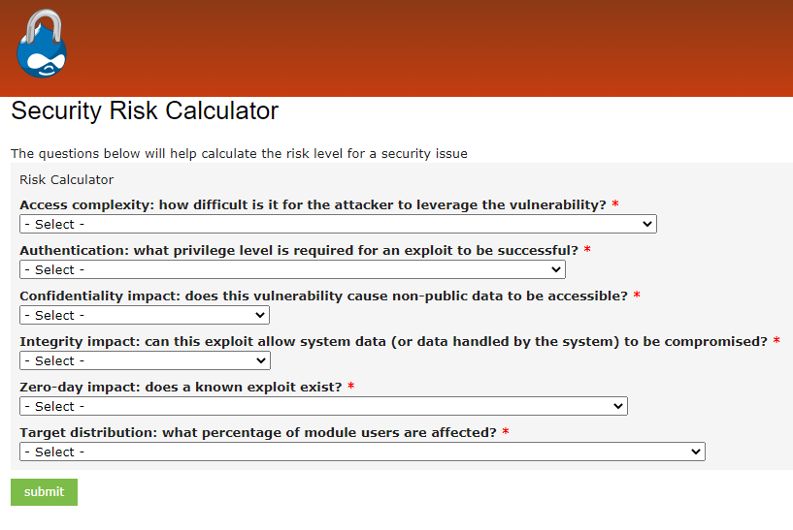
Activity 5: Risk calculation
Online calculator

